Slide 1
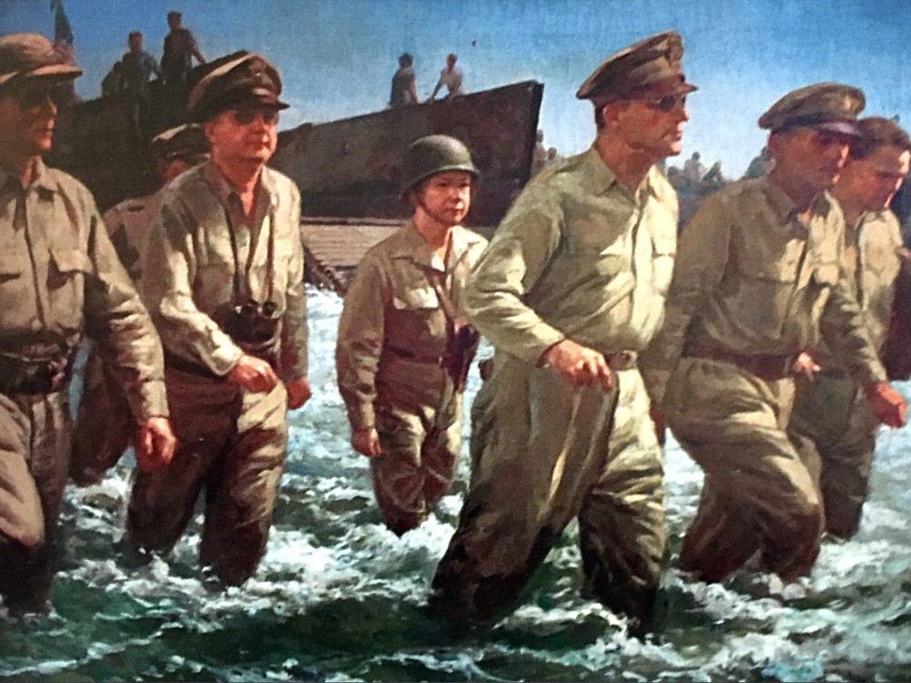
JUAN LUNA & FERNANDO AMORSOLO

Slide 2
Background of the Artists

Slide 3
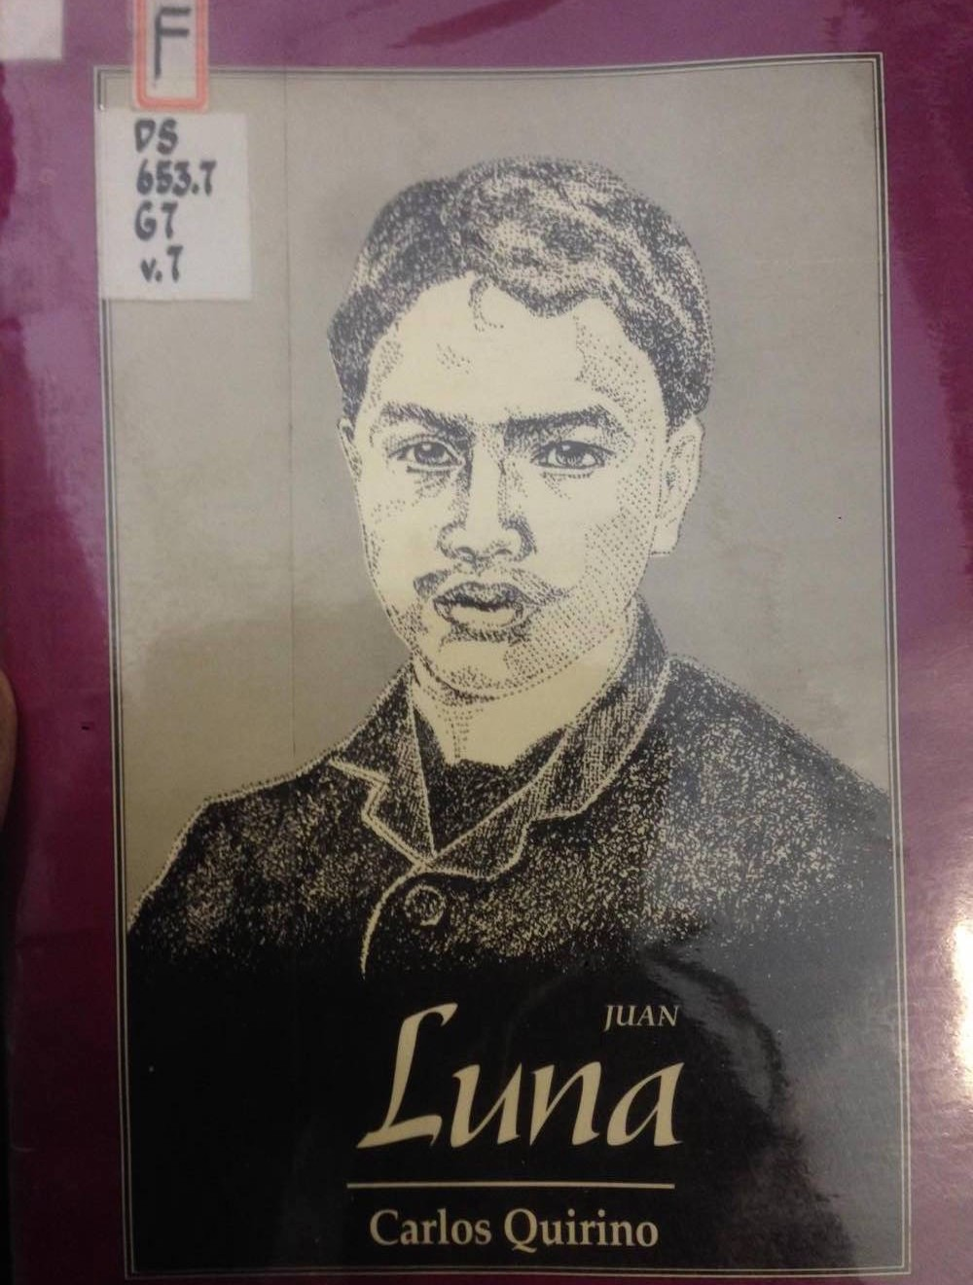
Juan Luna y Novicio
(1857-1899)

Slide 4
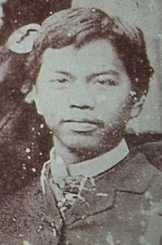
First Internationally known Painter
Birth: October 23, 1857 (Ilocos Norte)
Parents
Joaquin Luna de San Pedro y Posadas
Laureana Novicio y Ancheta
Siblings
Numeriana
Manual Andres
Remedios
Jose
Joaquin Damaso
Antonio

Slide 5
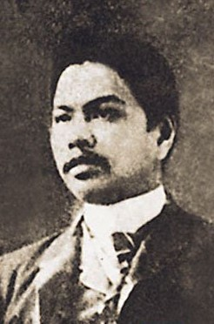
JUAN LUNA
Education:
➤
Early education: From his mother, Laureana (6-8 years)
Elementary: Ateneo Municipal de Manila (8-12 years)
High School: Escuela Nautica de Manila (12-16 years)
College: Academia de Dibujo y Pintura (Academy of Fine Arts, in Manila)
Further studies: Escuela de Pintura at the Academia de Bellas Artes de San Fernando, Madrid (21 years)
➤
➤
➤
➤

Slide 6
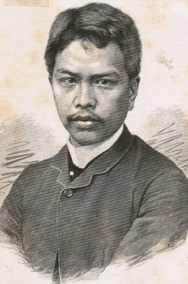
JUAN LUNA
Personal Life
➤
Wife: Maria de la Paz Pardo de Tavera
Kids: Andres (Luling) Luna and Maria Paz (Bibi) Luna
➤
Career
➤
Nautical officer. Passed the government examinations and granted the title of Licentiate Pilot for High Seas
Diplomatic agent in Paris for the Philippine Revolutionary Government based in Hong Kong in 1898
➤

Slide 7
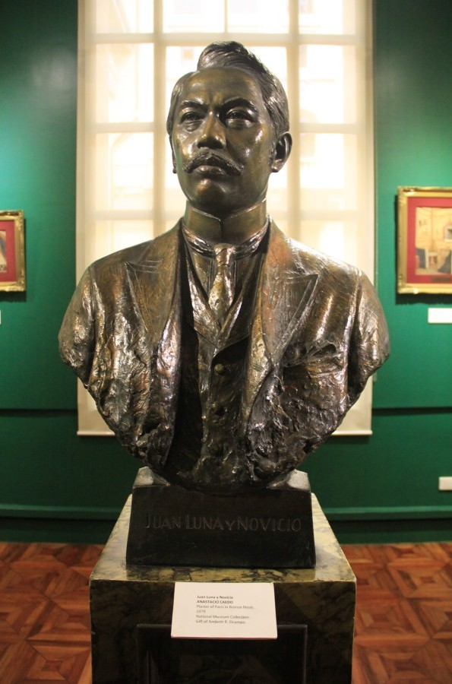

JUAN LUNA
➤
Recognition
Silver Medal for: LA MUERTE DE CLEOPATRA (Rome, 1881)
(Death of Cleopatra)
Silver Palette for: DAFINIS Y CLOE (Rome, 1881) (Roman Youth)
1st Gold Medal (1st Class): SPOLIARIUM (Rome, 1884)
Silver Palette with Laurel: SPOLIARIUM
1st Gold Medal (3rd Class): SPOLIARIUM

Slide 8
JUAN LUNA
Diploma of Honor: LAS DAMAS ROMANAS (Paris, 1886) (Roman Ladies)
Diploma of Honor: LA MESTIZA EN SU TOCADOR (Venice, 1886)
(The “Mestiza” in her Boudoir)
Gold Medal—Special Award: LA BATALIA DE LEPANTO (Paris
1887) (The Battle of Lepanto)
Bronze Medal: HYMEN, OH, HYMENEE (Venice, 1886) (A
Roman Wedding)
Honorary Award: CHIFFONIER (Paris, 1888)

Slide 9
JUAN LUNA
Gold Medal (Posthumous Award): PEUPLE ET ROIS (Paris 1892) (El
Pueblo y Los Reyes — The People and Kings)
Silver Medal (Posthumous Award): EL PACTO DE SANGRE (Paris, 1885)
(The Blood Compact)
Silver Medal (Posthumous Award): DON MIGUEL LOPEZ DE LEGASPI
(Paris 1885)
Decoration: MEDAL — ISABELA LA CATOLICAL “A la Lealtad Acrisolada”
Decoration: MEDAL — Medalla de 1ª Clase (para Cabellero) “In Hoc Signo Salus”

Slide 10
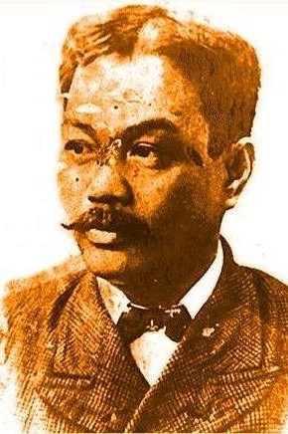
JUAN LUNA
Death
∙
Early December 1899, Luna arrived in Hong Kong
Two days later, he suffered a heart attack.
A second attack on December 7, 1899 proved fatal before a doctor could reach him.
He died at 42 years old.
He was buried in Hong Kong.
Two years later his remains were brought to Manila for final burial.
∙
∙
∙
∙
∙

Slide 11
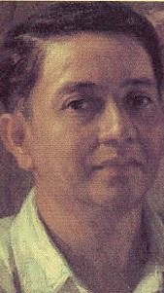
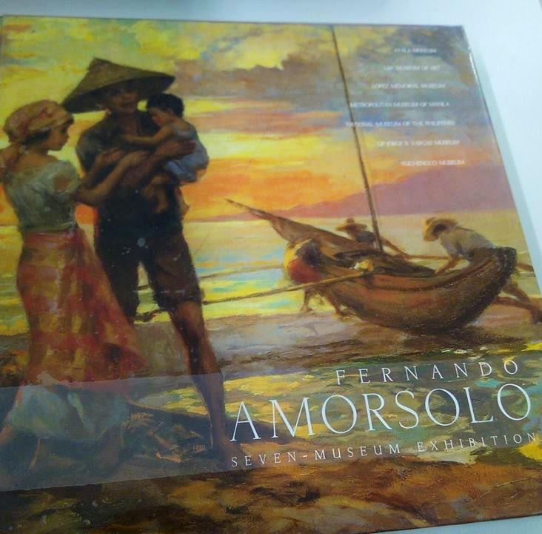
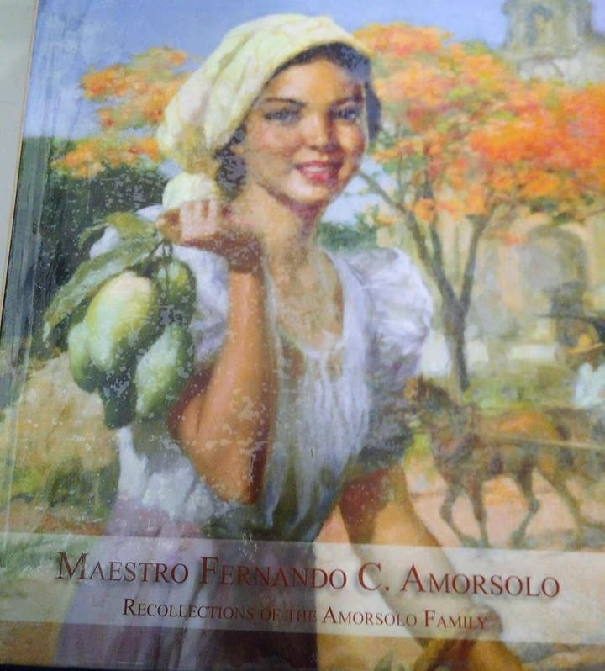
Fernando Amorsolo
(1892-1972)

Slide 12
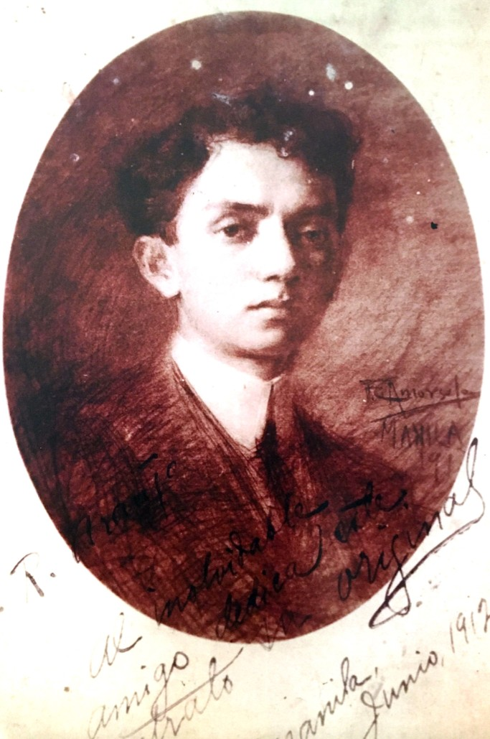
FERNANDO AMARSOLO
“Grand Old Man of Philippine Art”
Birth: May 30, 1892
(Calle Heran (now known as Pedro Gil), Paco, Manila)
Honed his skills in Daet, Camarines Norte
Parents
Pedro Amorsolo
Bonifacia Cueto
Brothers
Pablo Amorsolo
Alejandro Amorsolo
Perico Amorsolo (Half)
Self-portrait at the age of 20
Fernando Amorsolo

Slide 13
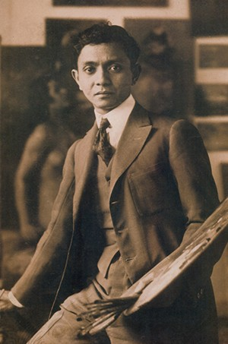
FERNANDO AMARSOLO
➤
Education
➤
Art School of the Liceo de Manila
University of the Philippines School of Fine Arts
Academia de San Fernando (in Madrid)
➤
➤
➤
Past Occupations
➤
Director of UP School of Fine Arts
Draftsman and chair designer
for the Bureau of Public Works
Chief artist at the Pacific Commercial Company
➤
➤

Slide 14
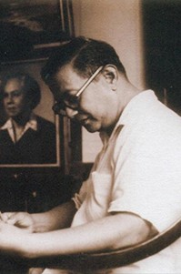
FERNANDO AMARSOLO
➤
Spouses
➤
Salud Tolentino Jorge
Virginia Guevarra Santos Maria del Carmen
➤
➤
➤
Significant People
➤
Don Fabian de la Rosa
Joaquín Sorolla Bastida and Ignacio Zuloaga
Enrique Zobel de Ayala
➤
➤

Slide 15
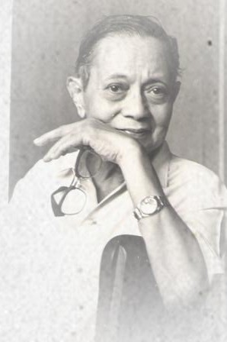
FERNANDO AMARSOLO
➤
Recognition
➤[1927] First Prize - General Painting at the Manila Carnival Commercial and Industrial Fair
➤[1939] First Prize - "Afternoon Meal of Rice Workers" at the New York World's Fair
➤[1959] Gold Medal of Recognition from the UNESCO National Commission
➤[1961] Rizal-Pro Patria Award and Doctor of Humanities (Honoris Causa) from the Far Eastern University
➤[1963] Araw ng Maynila Award for Painting

Slide 16
FERNANDO AMARSOLO
➤[1972] First National Artist of the Republic of the Philippines
➤[1992] Conferment of the Doctor of Humanities, Honoris Causa, by the University of the Philippines on September 30 (1992)
➤[2008] "Parangal Sentenyal" at the University of the Philipppines" June 16 (2008)

Slide 17
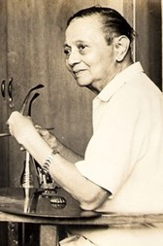
FERNANDO AMARSOLO
Death: April 24, 1972 (due to heart failure)

Slide 18
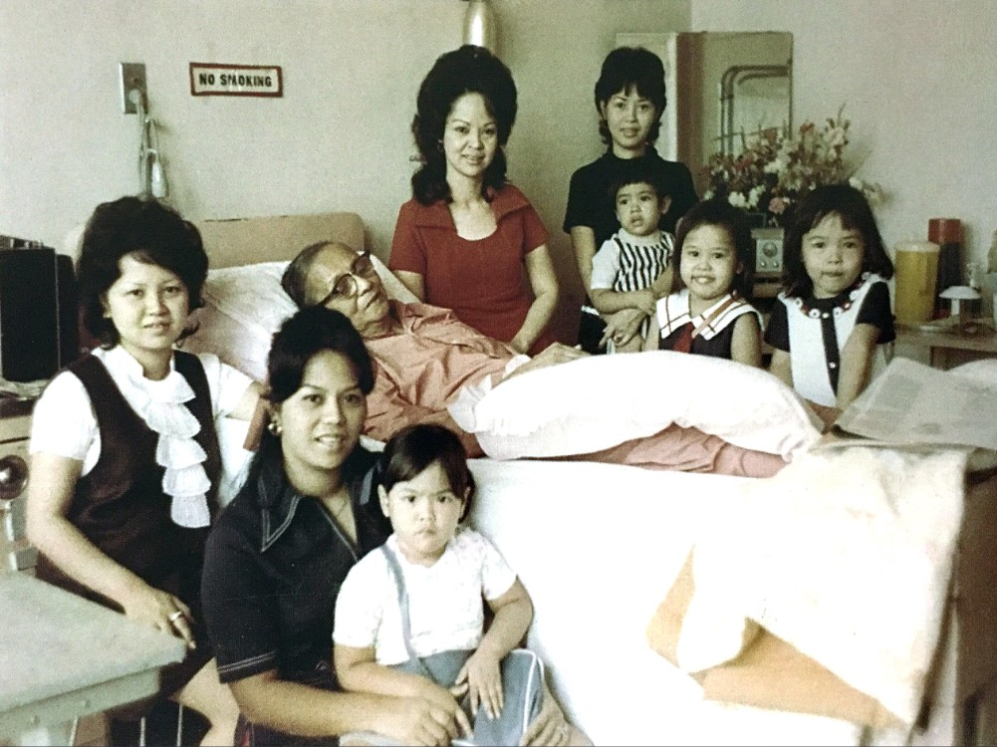

Slide 19
Context of the Artworks

Slide 20
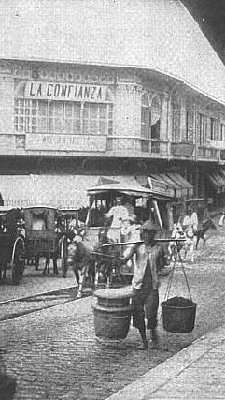
SPANISH COLONIZATION
Late 19th century

Slide 21
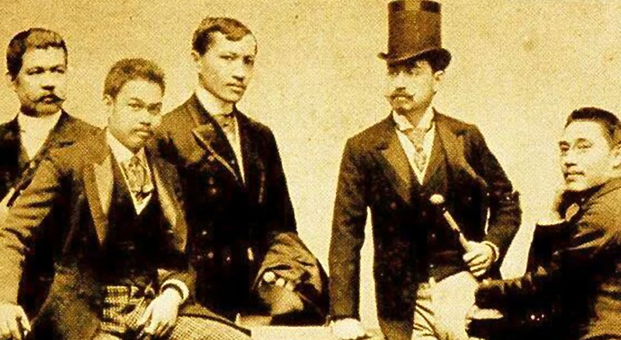
LOS INDIOS BRAVOS
“Great Filipinos”
Jose Rizal organized a local group of paisanos (countrymen)
Part of the group:
Rizal
The two Luna brothers Valentin Ventura
Meeting place: Luna’s garden at the Rue de Pergolese
➤
➤
➤
➤

Slide 22
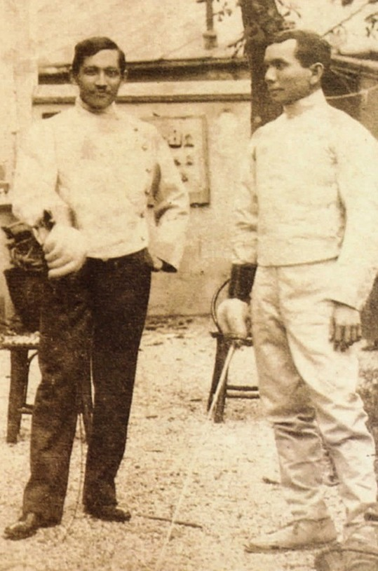
INDIOS BRAVOS
➤
Grew out of love of chivalry and bravery
Activities:
Practice fencing with foils
practice target shooting with Rizal’s pair of pistols
➤

Slide 23
Ang Mahiwagang Ngiti ni Rizal
Part 2
Part 3

Slide 24
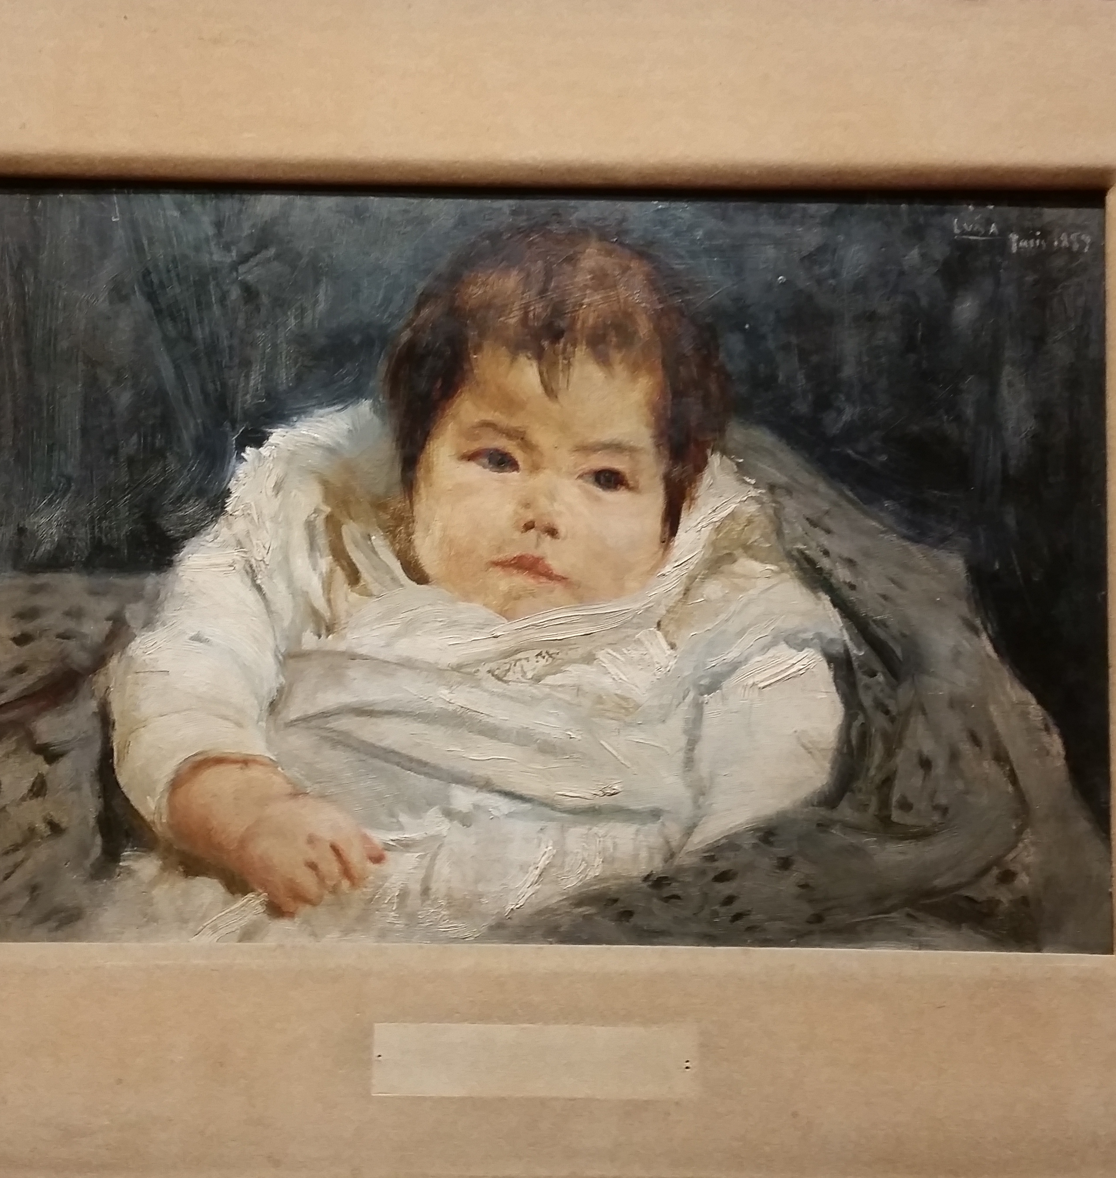
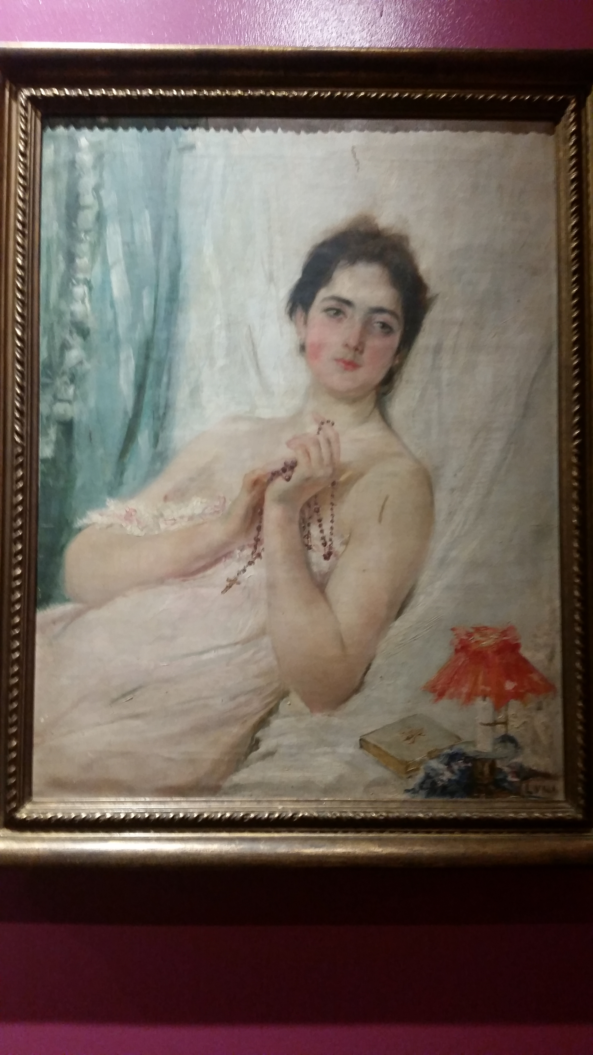
Portrait of a Lady

Slide 25
Portrait of a Lady
https://www.youtube.com/watch?v=NIJByf_qT4g

Slide 26
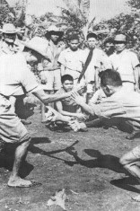
FILIPINO MISERY
➤
Luna became interested in the lives of poor people
He wanted a Rizal book that “relates in relief the misery of our present-day society.”
Expose:
➤
➤
➤
Horrors and the miseries that the friars put upon the Filipinos
Countrymen are strong despite all the hardships.
➤

Slide 27
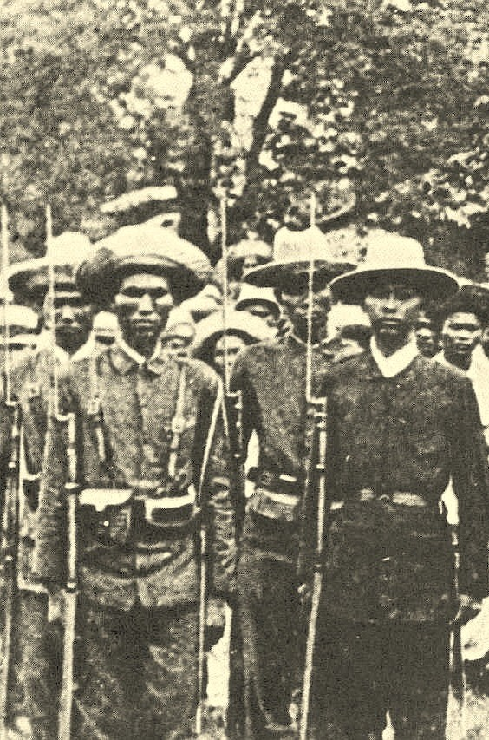
THE KATIPUNAN
➤
August of 1896: A revolutionary tempest started in Katipunan
August 19: Spanish officials found out about the Katipunan
September 16: The Lunas were arrested and brought to Fort Santiago in Intramuros for questioning.
➤
➤

Slide 28
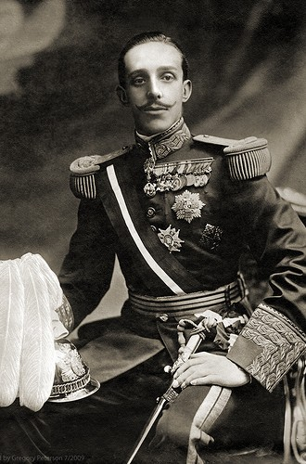
LUNA’S IMPRISONMENT
➤
Juan Luna was imprisoned for eight months
Released as a generous gesture from the Spanish king (on King Alfonso XIII’s birthday)
Antonio Luna was shipped to Spain as a prisoner
Antonio told the Spanish authorities that Dr. Rizal supported the revolution
➤
➤
➤

Slide 29
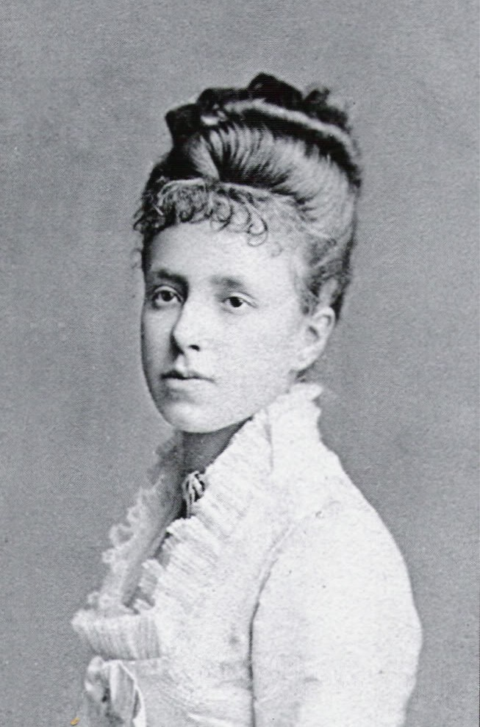
ANTONIO’S RELEASE
Juan Luna sailed to Madrid to ask the Queen Regent of Spain to grant pardon to Antonio, which the Queen Regent granted.

Slide 30
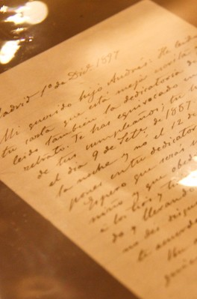
LUNA’S LETTER TO ANTONIO
➤
Luna preferred to serve his country as a soldier in battle rather than as a diplomat.
He wanted the Philippines to be free of Spanish and American rule.
He was also open to the idea that the Philippines become an American protectorate.
➤
➤

Slide 31
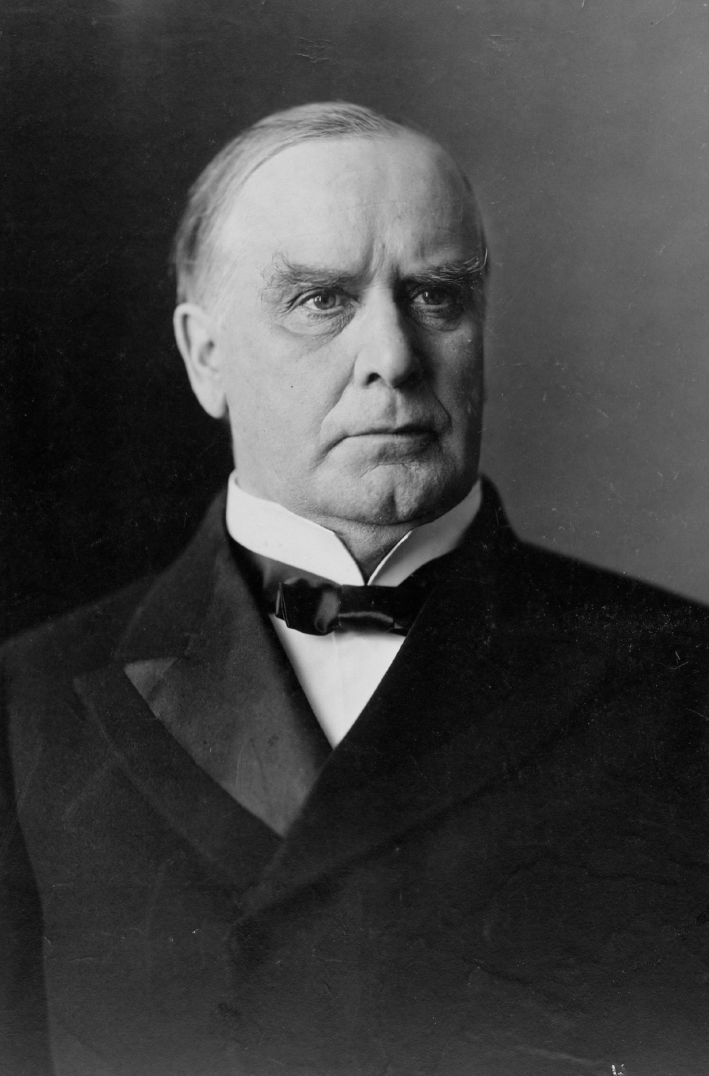
PHILIPPINES’ INDEPENDENCE
➤
December 1898: US and Spain signed the Treaty of Paris
Luna went to Washington DC to plead for Philippines’ independence
US President McKinley already announced that the US would keep the Philippine archipelago.
➤
➤

Slide 32
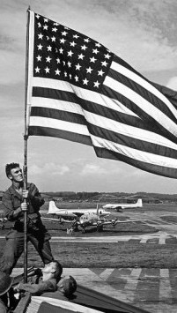
AMERICAN
OCCUPATION
Early 20th century

Slide 33
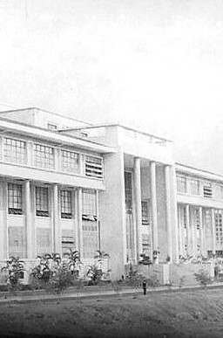
END OF SPANISH COLONIALISM
➤
Last generation of teachers of Spanish-period academia
UP School of Fine Arts
➤
➤
Established by the Americans (1908)

Slide 34
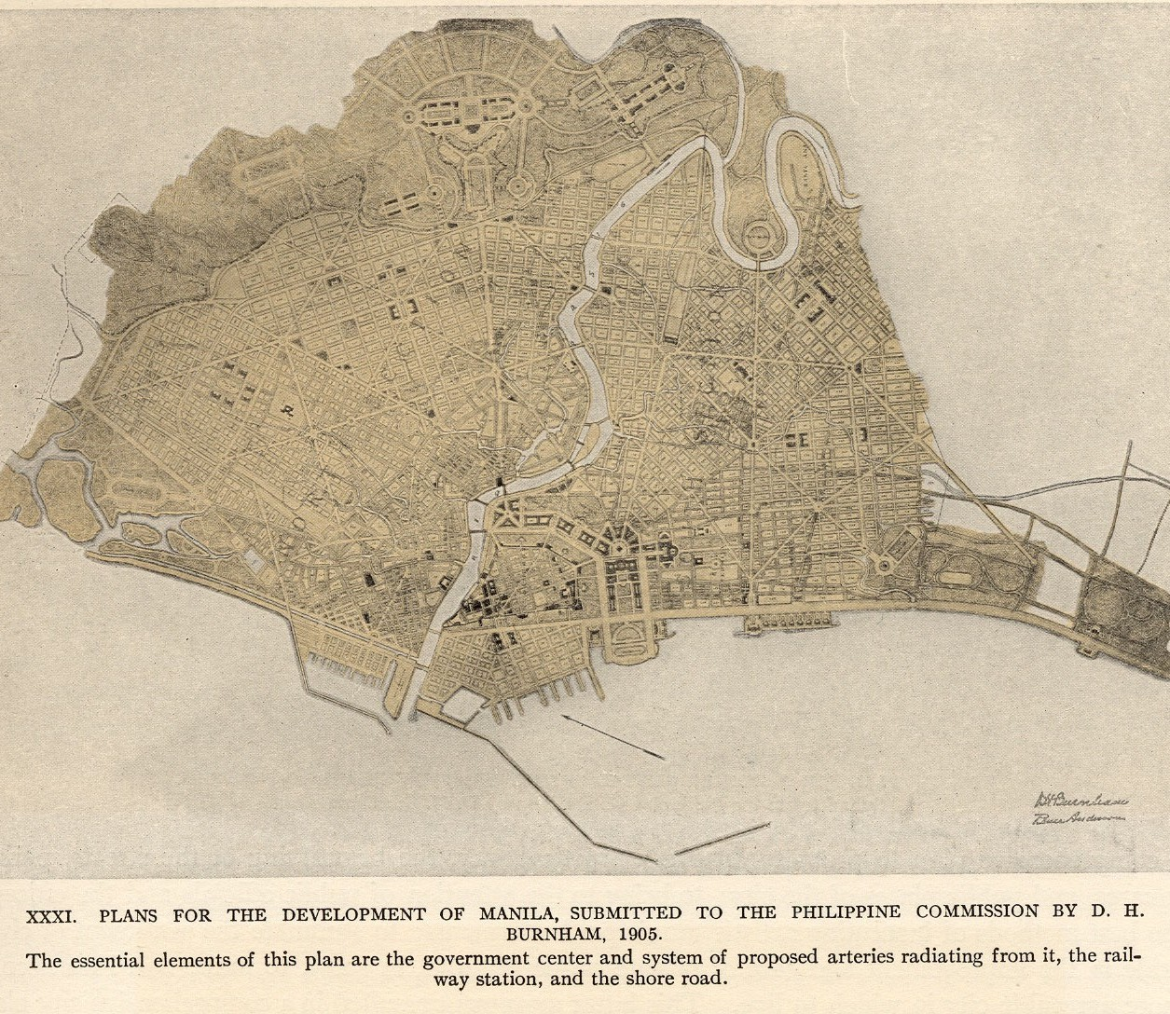
AMERICAN OCCUPATION
A time of peace, hope and prosperity
➤
Burnham Plan
➤
Plan created by
Daniel Burnham
Institution of public education, public health and infrastructure, etc.
➤
➤
Field of visual arts: Americans were also patrons of Visual Arts

Slide 35
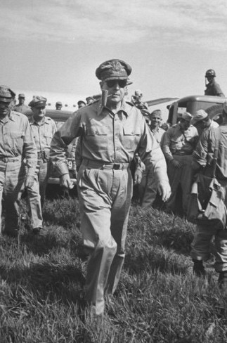
AMERICAN OCCUPATION
➤
December 8, 1941 - War broke out when Japan launched an attack on the Philippines after Pearl Harbor
Filipino and American forces lead by General Douglas MacArthur
December 26, 1941 - “Open City” Manila
January 1, 1942 - Manila was in a state of panic
➤
➤
➤

Slide 36
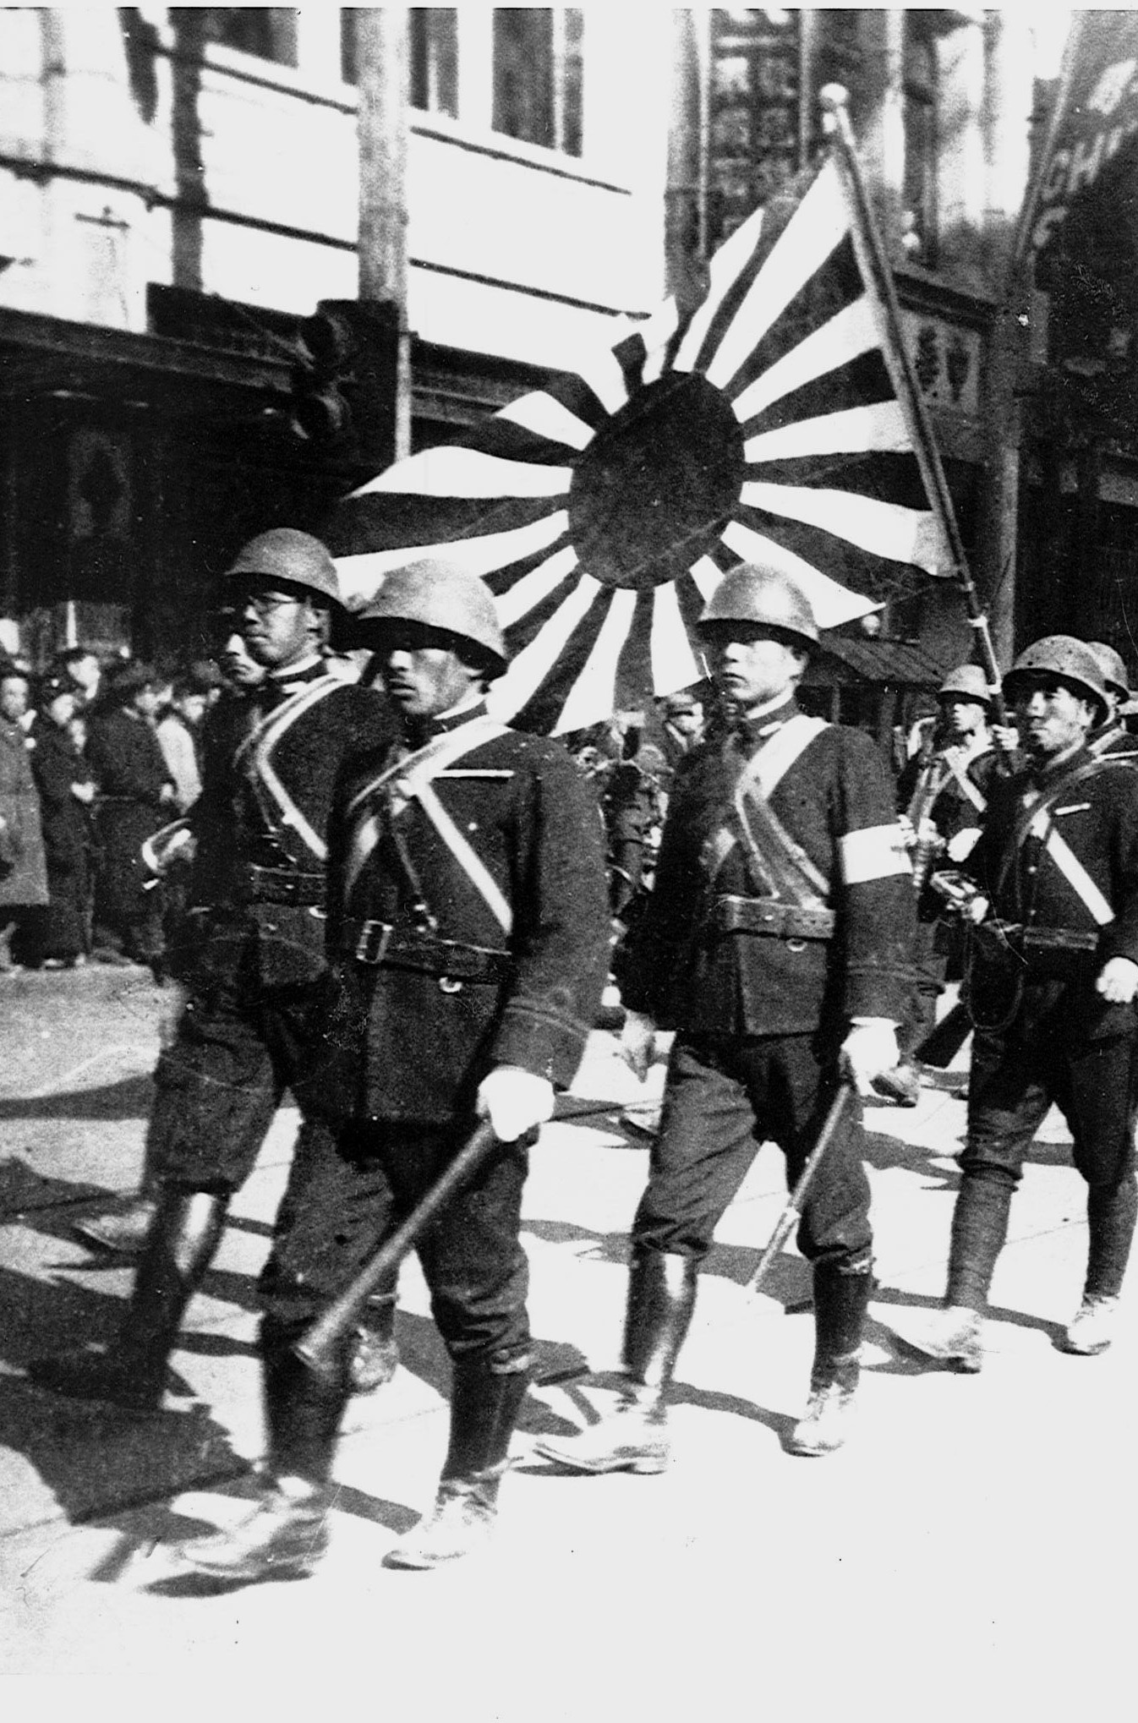
AMERICAN OCCUPATION
➤
January 2, 1942 - Manila was occupied by Japanese forces
Amorsolo was fascinated and painted the surroundings in different versions: New Year 1942, Burning of Manila 1942, Bombing of the Intendencia
There was scarcity and massive inflation
➤
➤

Slide 37
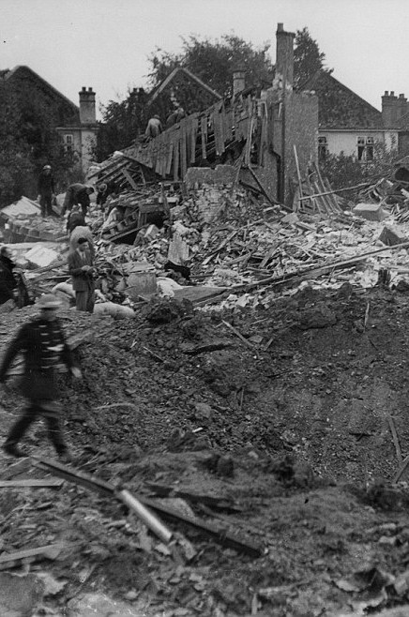
AMERICAN OCCUPATION
➤
Amorsolo's son, Junior, was arrested by the Japanese
Japanese propaganda regarding the status of Filipino women were participating not only with family decision making but also with the war
Bombing of Grace Park (1944)
American troops entered Manila = MORE CHAOS
➤
➤
➤

Slide 38
Juan Luna’sWorks
Content of the Artworks

Slide 39
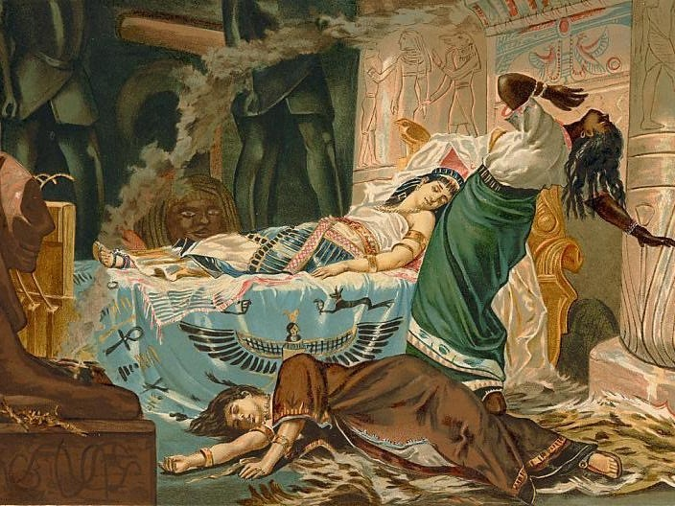
The Death of Cleopatra
Juan Luna (1881)

Slide 40
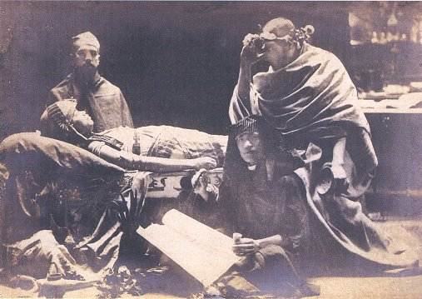

Slide 41
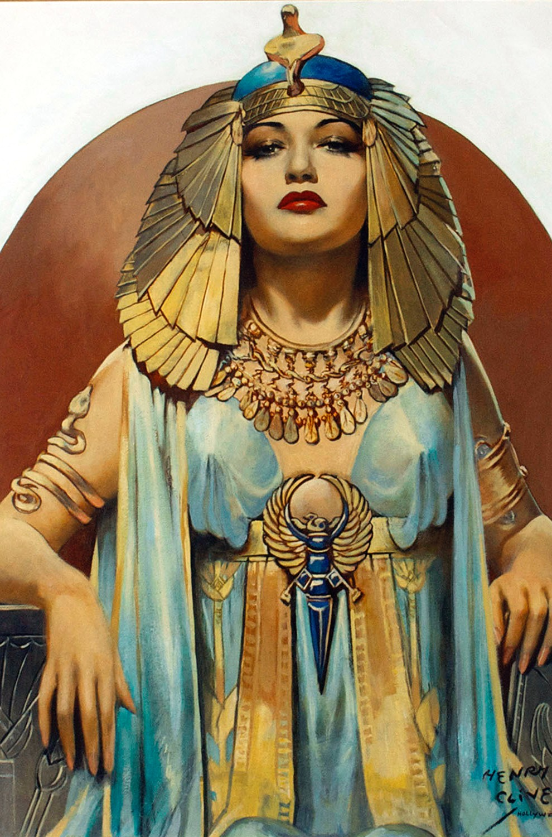
CLEOPATRA
➤
Dominant ruler in all three of her co-regencies
Seduced Mark Antony
Took her own life by succumbing willingly to the bite of a cobra
➤
➤

Slide 42
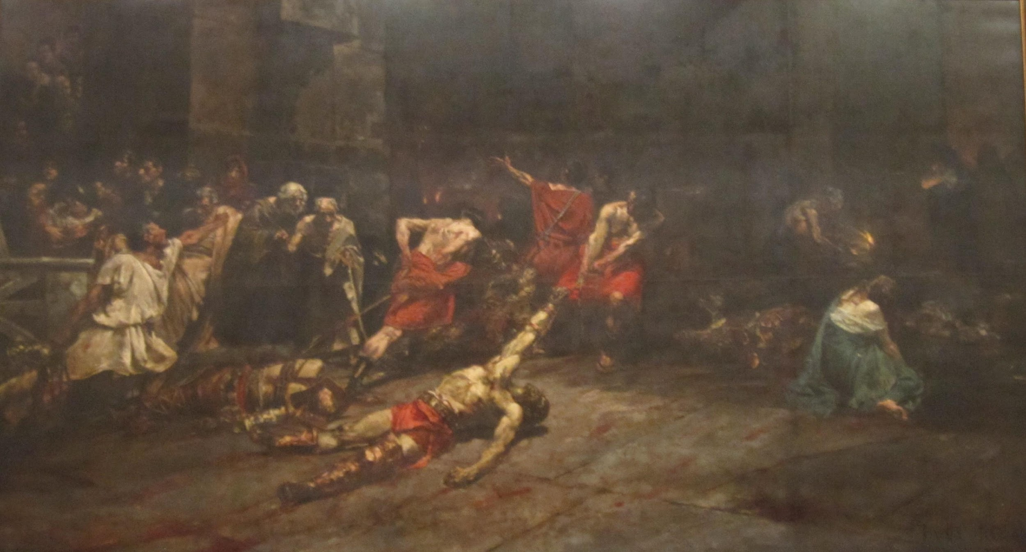
Spoliarium
Juan Luna (1884)

Slide 43
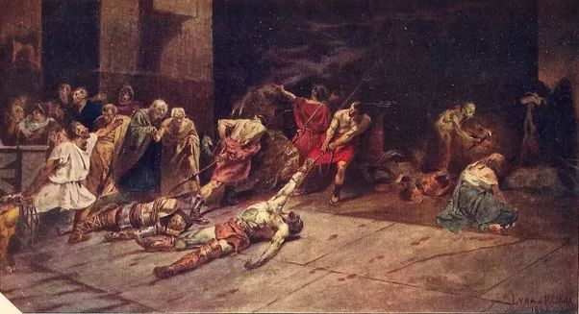

Slide 44
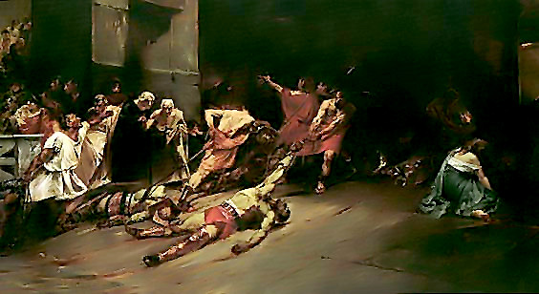
El Spoliarium
An 1884 oil painting that measures 4.22 meters x 7.675 meters made in Rome.
Won First Gold Medal at Exposicion de Bellas Artes (Madrid Art Exposition, May 1884).
Filipinos and Spaniards.
Fallen Gladiators and Romans
Cruelty of Romans towards the fallen Gladiators

Slide 45
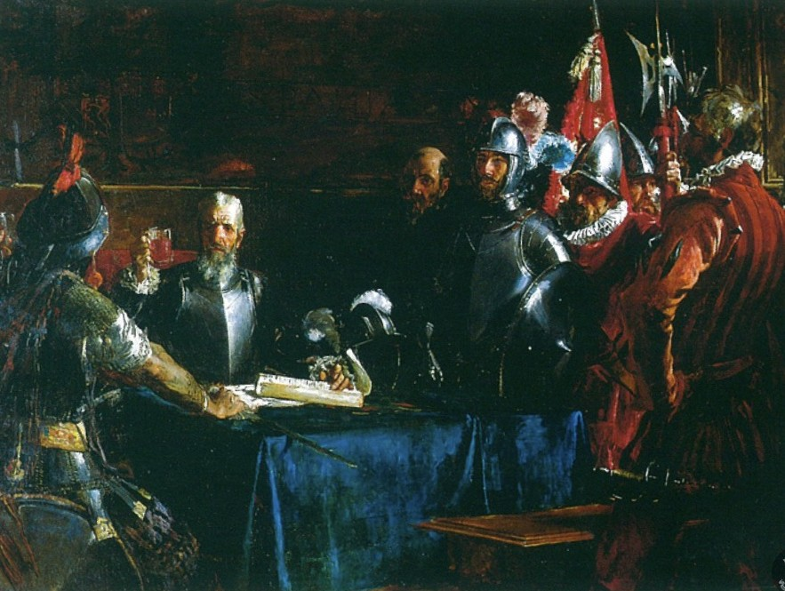
The Blood Compact
Juan Luna (1886)

Slide 46
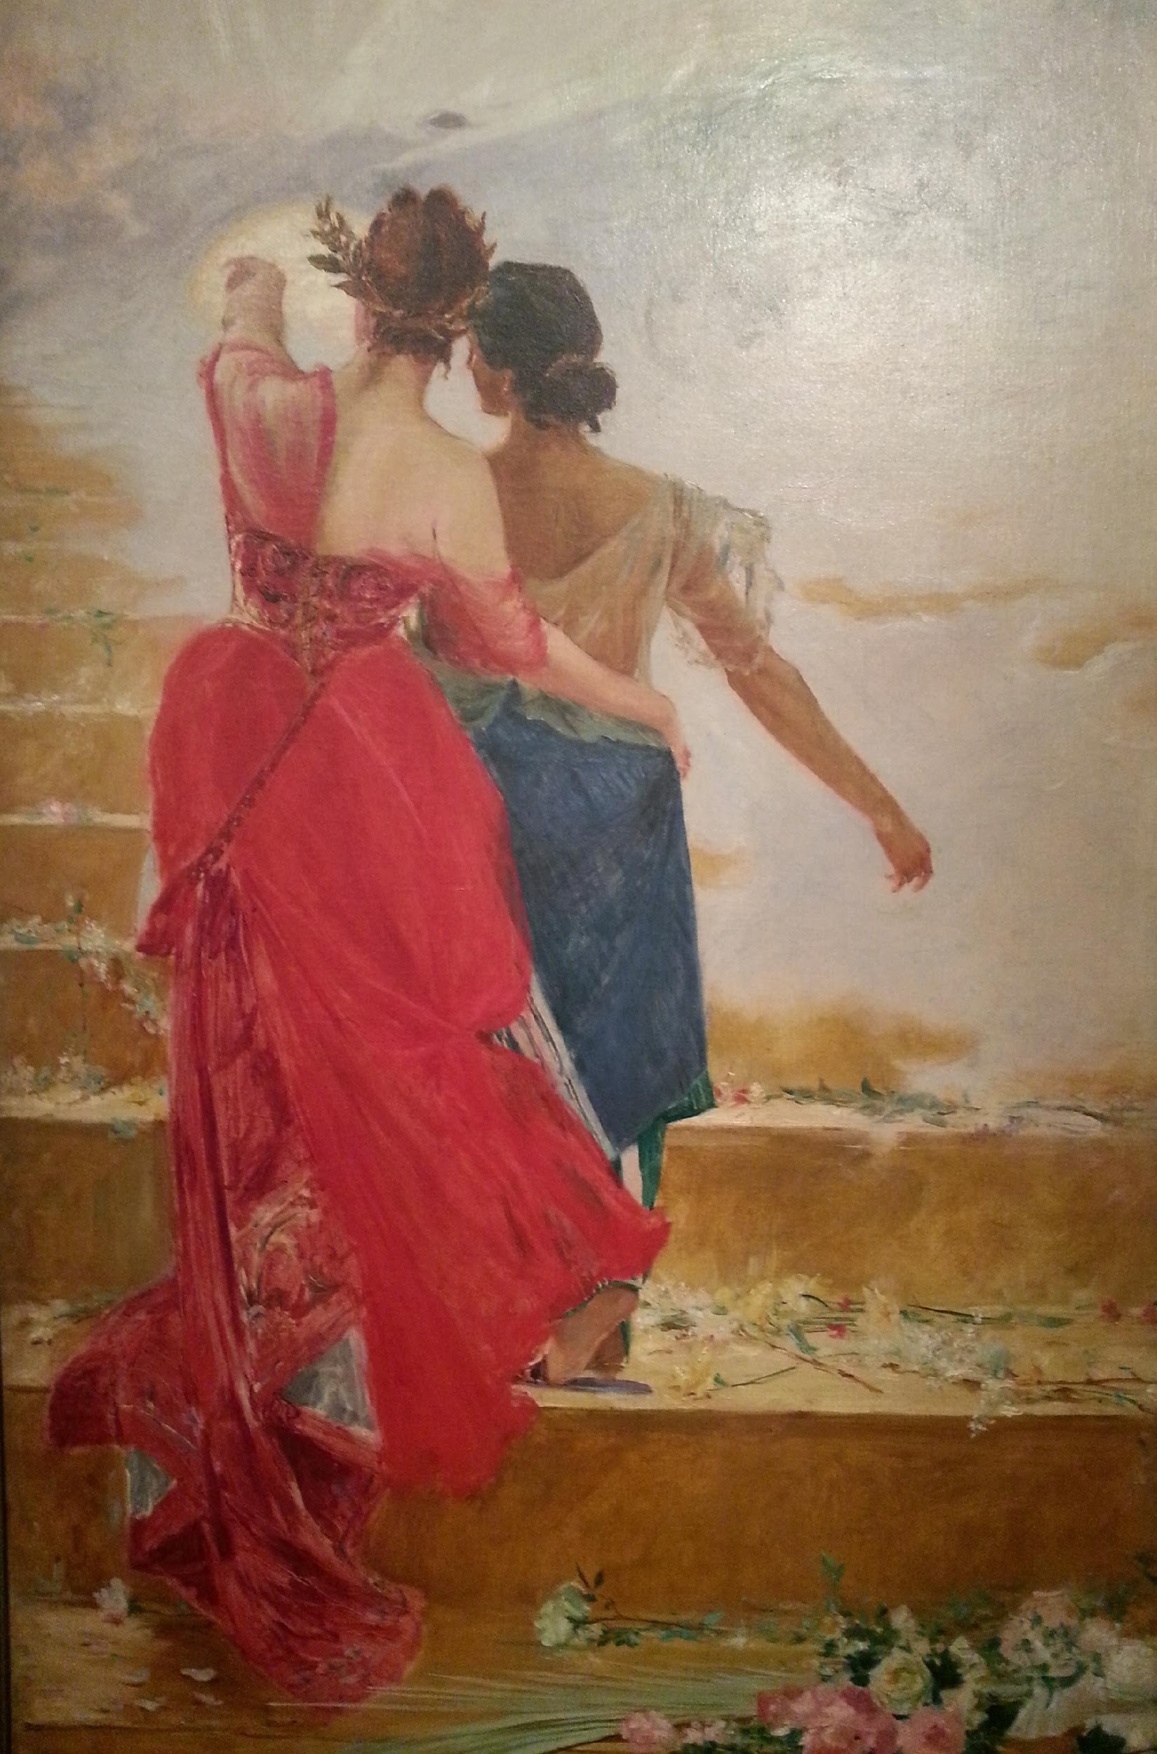
España Y Filipinas
Juan Luna
(1886)

Slide 47
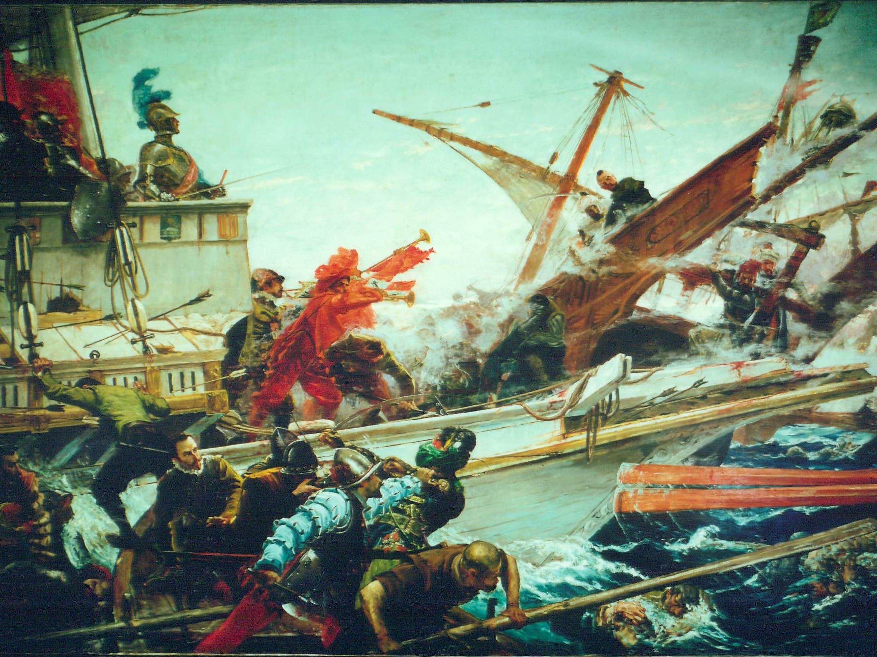
The Battle of Lepanto
Juan Luna (1887)

Slide 48
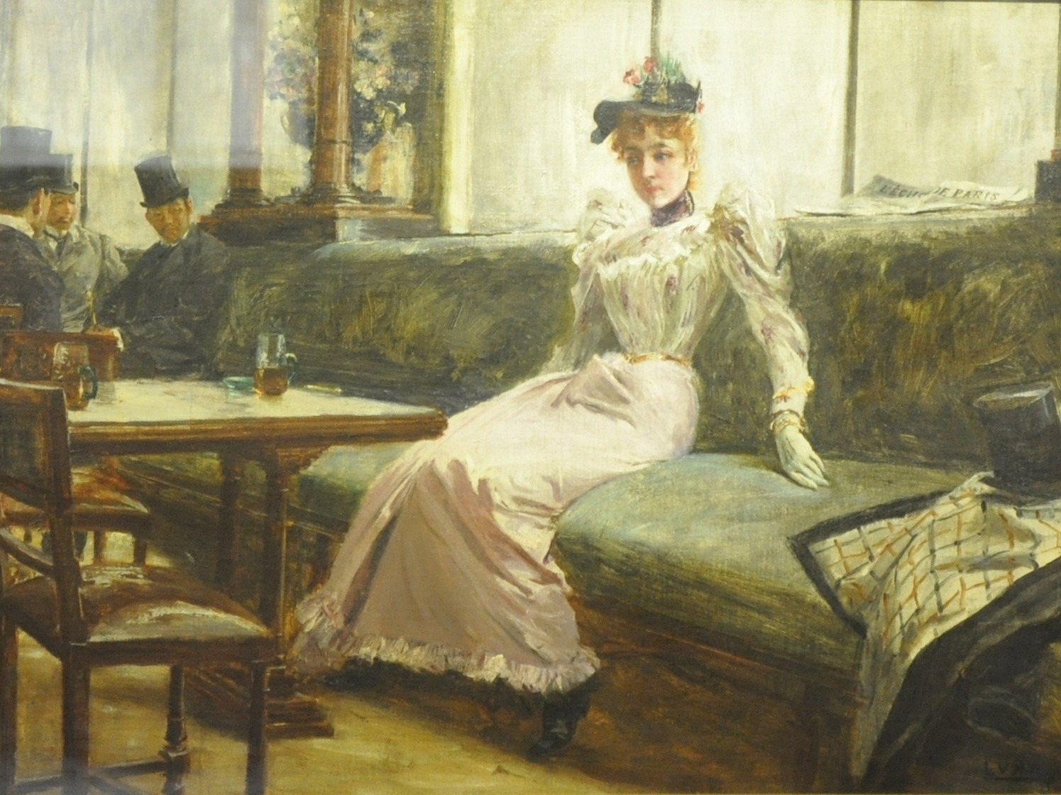
The Parisian Life Juan Luna (1892)

Slide 49
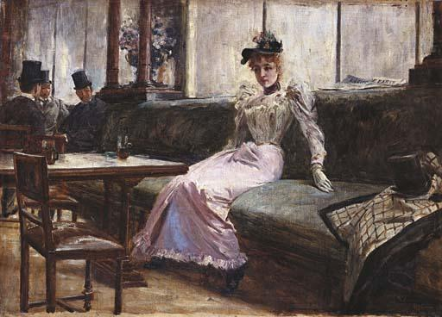
The Parisian Life
(Interior d'un Cafi)
An 1892 oil on canvas impressionist painting that measures 22” x 31” made in Paris, France
Won the silver medal award in 1904 at the St. Louis Exposition in the United States
Considered to be one of the last major works Luna has done during his post-academic and life in Paris
Provenance of Dr. Ariston Bautista Lin
Now owned by GSIS and is housed in the National Museum (Bought from Christie’s Hong Kong in 2002 for Php 46,000,000)

Slide 50
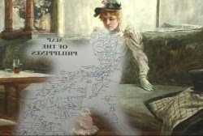

Slide 51
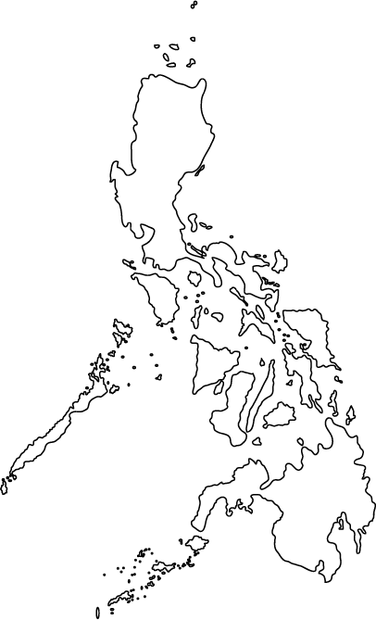
BULACAN
CEBU

Slide 52
L’Echo de Paris
“Hanged”
Half-filled
Colonizer
Full

Slide 53
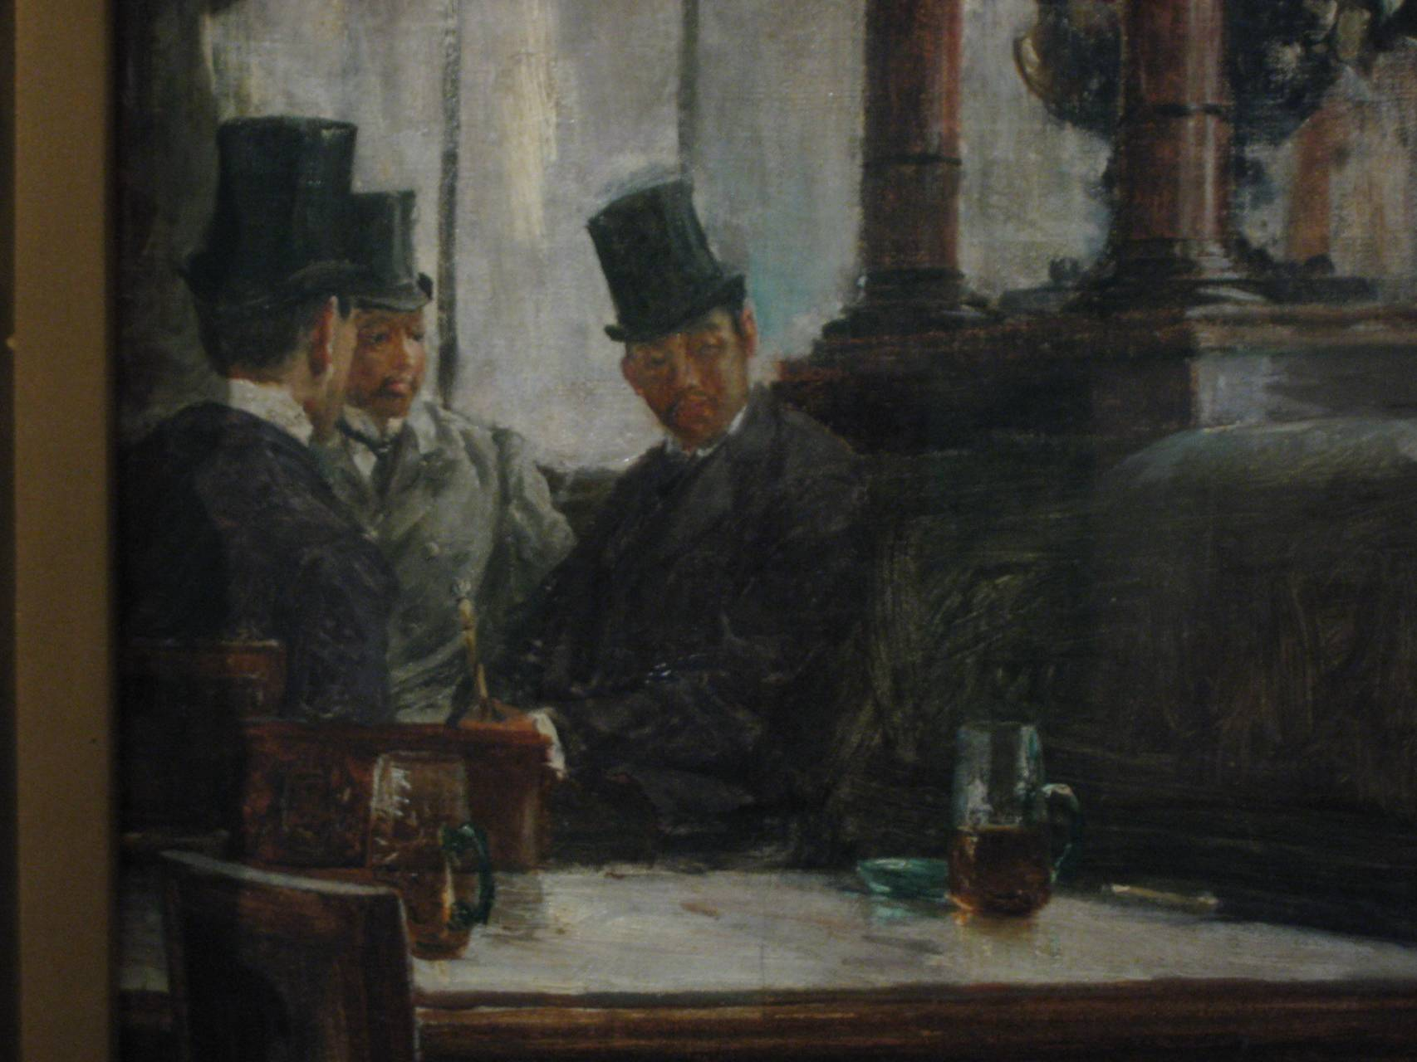
Juan Luna
Dr. Jose Rizal
Dr. Ariston Bautista Lin

Slide 54
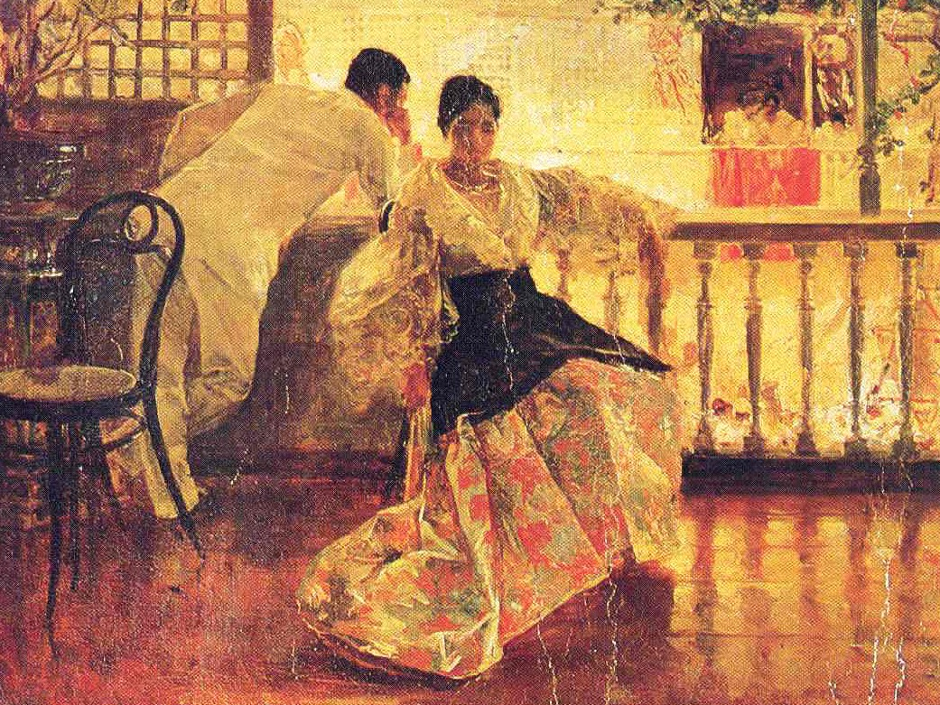
Tampuhan Juan Luna (1895)

Slide 55
Fernando Amorsolo’s Works
Content of the Artworks

Slide 56
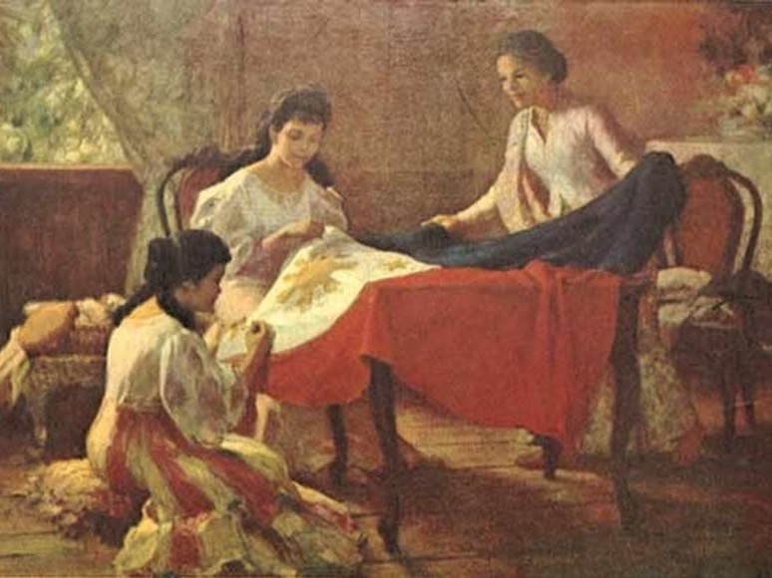
Making of the Philippine Flag
Fernando Amorsolo

Slide 57
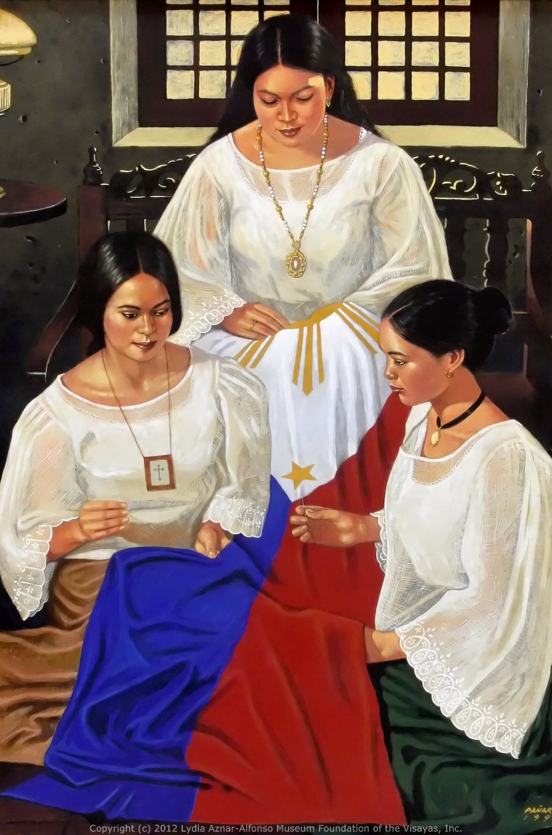
MAKING OF THE
PHILIPPINE FLAG
➤
Doña Marcela Marino de Agoncillo
Lorenza Agoncillo
Delfina Herbosa de Natividad
➤
➤
➤
Sewn in Hong Kong

Slide 58

Palay Maiden Fernando Amorsolo (1920)

Slide 59

Fruit Pickers Harvesting Under The Mango Tree
Fernando Amorsolo
(1939)

Slide 60


The Offering Fernando Amorsolo (1941)
Nude with Orchids Fernando Amorsolo (1939)

Slide 61

WOMEN IN HIS PAINTINGS
Nude with Flower Fernando Amorsolo (1919)
➤
Often seen as beautiful figures
Project a liberating attribution
Amorsolo refused to depict them as exacting realistic representations of critical situations.
He oscillates between the beautiful and what was behind it, its "otherness".
➤
➤
➤

Slide 62

The Burning of Manila
Fernando Amorsolo
(1946)

Slide 63

The Rape of Manila
Fernando Amorsolo
(1942)

Slide 64

The Burning of Sto. Domingo
Fernando Amorsolo
(1942)

Slide 65

Defense of a Filipino Woman’s Honor Fernando Amorsolo (1945)

Slide 66

Fruit Gatherer Fernando Amorsolo (1950)

Slide 67

Portrait of Don Enrique
T. Yuchengco Fernando Amorsolo (1950)

Slide 68

Sunday Morning Going To Town
Fernando Amorsolo (1961)

Slide 69
Relevance to the Grand Narrative of Philippine History

Slide 70
Luna and Amorsolo Paintings
Even in other countries, both Luna’s and Amorsolo’s loyalties lie with the Philippines.
They used the opportunity abroad to be able to help the Filipinos and bring pride in our country.
Luna’s and Amorsolo’s paintings brought pride to the Philippines by showcasing Filipino talent.

Slide 71
Luna and Amorsolo Paintings
Today, Filipinos do vice-versa: they go to other countries not as diplomats of the country
But to turn their back against the Philippines.

Slide 72
Unit Reference
A Collection of some of Juan Luna’s masterpieces. 3 May 2016 Retrieved from https://kahimyang.com/kauswagan/articles/1315/a-collection-of-some-of-juan-lunas-masterpieces.
A Small Collection of Fernando Amorsolo’s paintings. 2 May 2016. Retrieved from https://kahimyang.com/kauswagan/articles/1372/a-small-collection-of-fernando-amorsolos-paintings.
Gomez, Jerome (2017). Behind the Curse of Juan Luna’s “Portrait of a Lady”. Esquire Magazine, 20 January 2017. Retrieved from https://www.esquiremag.ph/culture/arts-and-entertainment/crimes-and-punishment-a1549-20170120-lfrm3.
Ocampo, Ambeth (2018). The Mystery of the ‘Spoliarium’ ‘boceto’: Is it Real? Philippine Daily Inquirer, 2 September 2018. http://lifestyle.inquirer.net/304684/mystery-spoliarium-boceto-real/.
Ongcal, Alecs (2018). Juan Luna’s boceto of the Spoliarium surfaces. But is it real? Rappler, 2 September 2018. Retrieved from https://www.rappler.com/life-and-style/arts-and-culture/210947-juan-luna-boceto-spoliarium.
Martinez, Edwin (N.D.). Biography of Fernando Amorsolo. The Fernando C. Amorsolo Art Foundation. Retrieved from http://www.fernandocamorsolo.com/biography.html.
Torres, Eric (2004). In Focus: The Art of Juan Luna. Retrieved from http://ncca.gov.ph/about-culture-and-arts/in-focus/the-art-of-juan-luna/.
Villegas, Ramon (2018). Their Parisian Life: Luna and co. as dandies and flaneurs. ANCX.ph, 22 September 2018. Retrieved from https://news.abs-cbn.com/ancx/style/style-profile/09/22/18/theyll-always-have-paris.

Slide 73
Savage: Juan Luna sa Paris
https://www.youtube.com/watch?v=54R1nWALZFw

